Slide 1




ANALYSING MEDIUM AUTHORS
PROJECT LAB
Prepared by:
Sanyam Jain (214104020)
Guided By:
Dr. Amit Bhagat
Dr. Dheeraj Dixit

Slide 2


WHAT IS MEDIUM?
60-100M
Medium is a popular online platform that allows authors to publish articles on a diverse range of topics.
For data analysts, this is a rich source to explore the diverse data available on it to gain valuable insights.
Monthly Active Users
>1.2M
New Stories Every Month

Slide 3


FAUGET
INTRODUCTION
Conducting data analysis on Medium data can provide valuable insights into the various writer's ways of writing, their article content, and platform dynamics, which can inform decision-making and strategy development in various domains.
In this project, we tried to uncover interesting insights about Medium authors that can be helpful for content strategies and marketing trends. And that wasn't all! We also demonstrated how we employed sentiment analysis and summarization techniques to gain even deeper insights into the content of Medium articles.

Slide 4

AIM OF THIS PROJECT
To gain a deeper understanding of the characteristics of authors who are most active on the platform, including their demographic profiles, writing styles, topics of interest and major publication they are active into. This analysis aims to provide valuable insights that can inform content creation strategies, platform policies, and marketing approaches for authors, publishers, and Medium as a whole.

Slide 5
Finding top authors writing for a specific input topic. So that we can do our further analysis on the right sample data.
Finding user data including : bio, followers, following, social handle and more.
Finding each article’s data published by the author.
Finding topics the author writes about.
Finding the top publication the author publishes in.
Finding popularity of articles, based on clap count and voter count. And how it is related to corresponding topics and publications.
Operations on the content of article:
Doing sentimental analysis of the content.
Performing Summarization.

Slide 6

DATA COLLECTION
The first step in the process was to collect data from Medium using the Medium API. Their python package allowed us to access a wide range of information about articles, including author profiles, top contributing writers, article titles, publication dates, and more. The retrieved data was saved in a Pandas DataFrame for further analysis.

Slide 7
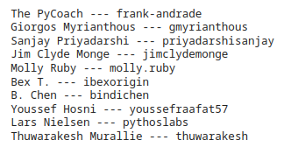
WHO TO ANALYZE?
THE TOP WRITERS OF MEDIUM...
It was a hectic task to decide on whose profile to perform the analysis. Whose profile could serve as an excellent test subject for our project?
In the end, we selected the profile of 'frank-andrade', who was the winner of the top writers list under the topic of 'data-science'.
Top writers of "data-science" on Medium

Slide 8
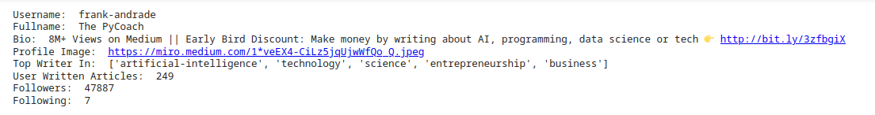

From the number of articles written by it can be concluded that this person is quite active and has written a lot about this field. He is successful in terms of followers - 47887 as well!

Slide 9
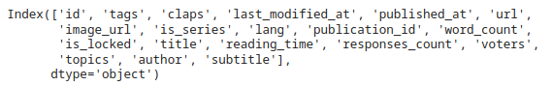

FETCHING DATA OF EACH ARTICLE WRITTEN BY USER
These are the fields of our dataset
Let's do some cleaning!

Slide 10

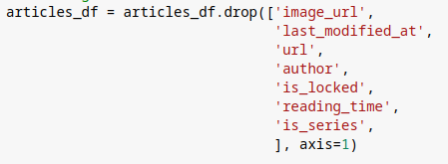
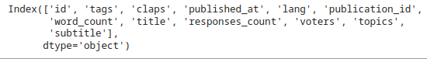
DATA CLEANING
Removing unnecessary fields

Slide 11
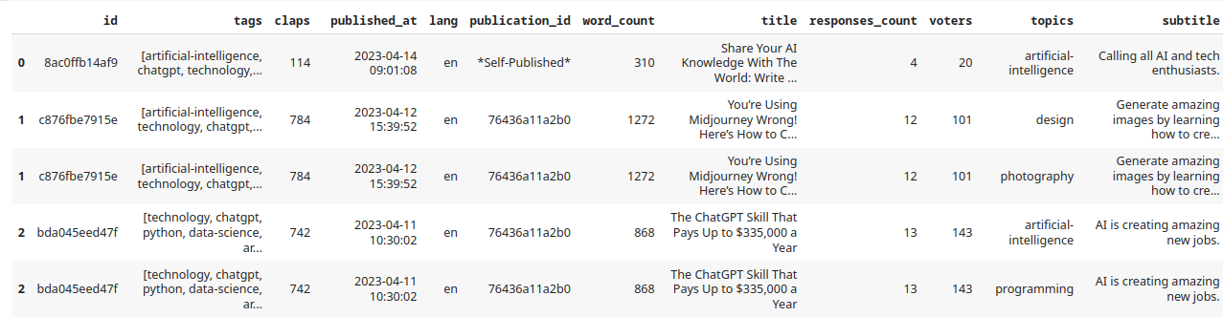
DATA CLEANING
Here's how our final data looks like

Slide 12
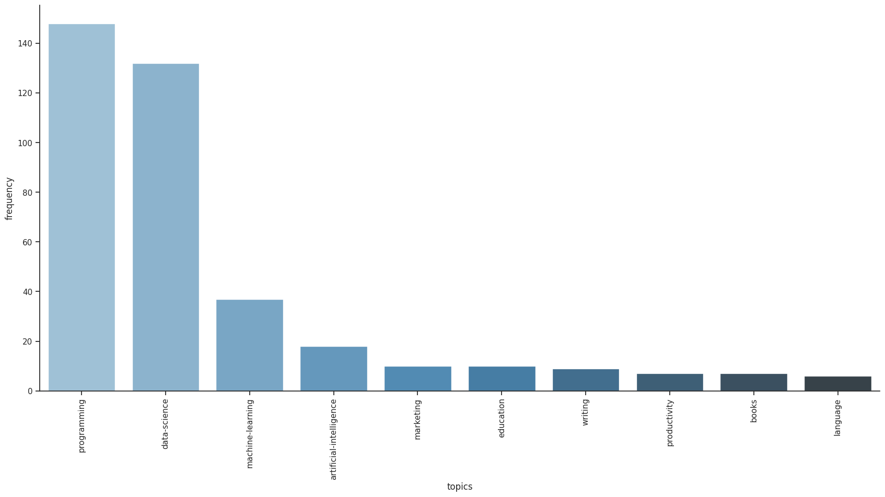
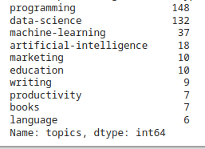

TOP TOPICS THE AUTHOR HAS MOST WROTE ABOUT (TOP 10) :

Slide 13
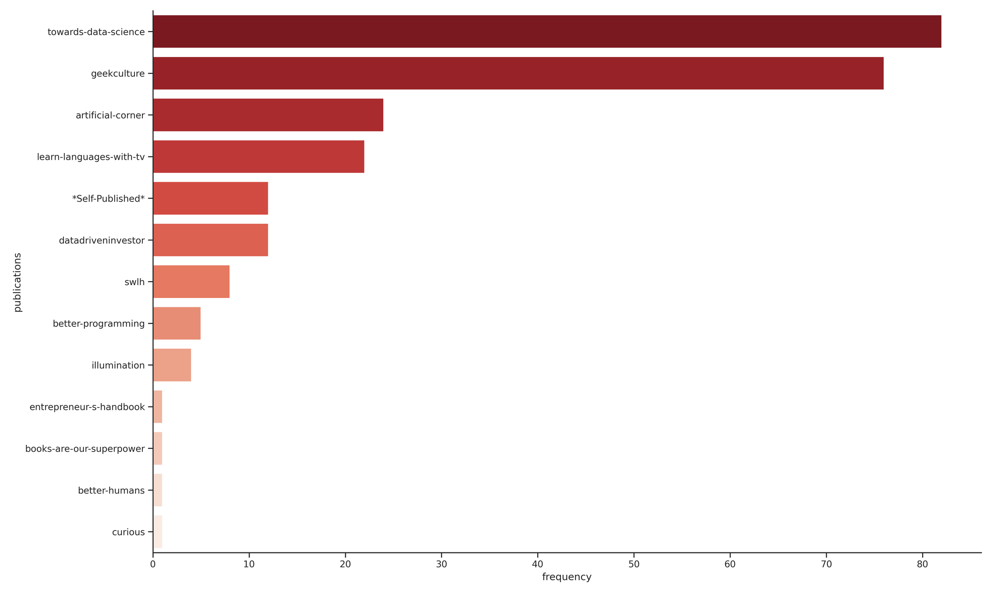
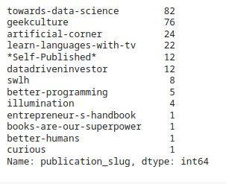

PUBLICATIONS THE AUTHOR HAS PUBLISHED MOSTLY

Slide 14

POPULARITY OF ARTICLES
Based upon the clap count and voter count we get a rough estimation of how well an article has received attention from its readers. And we have shown how this is related to the topic of the article and the publication in which it was published.

Slide 15
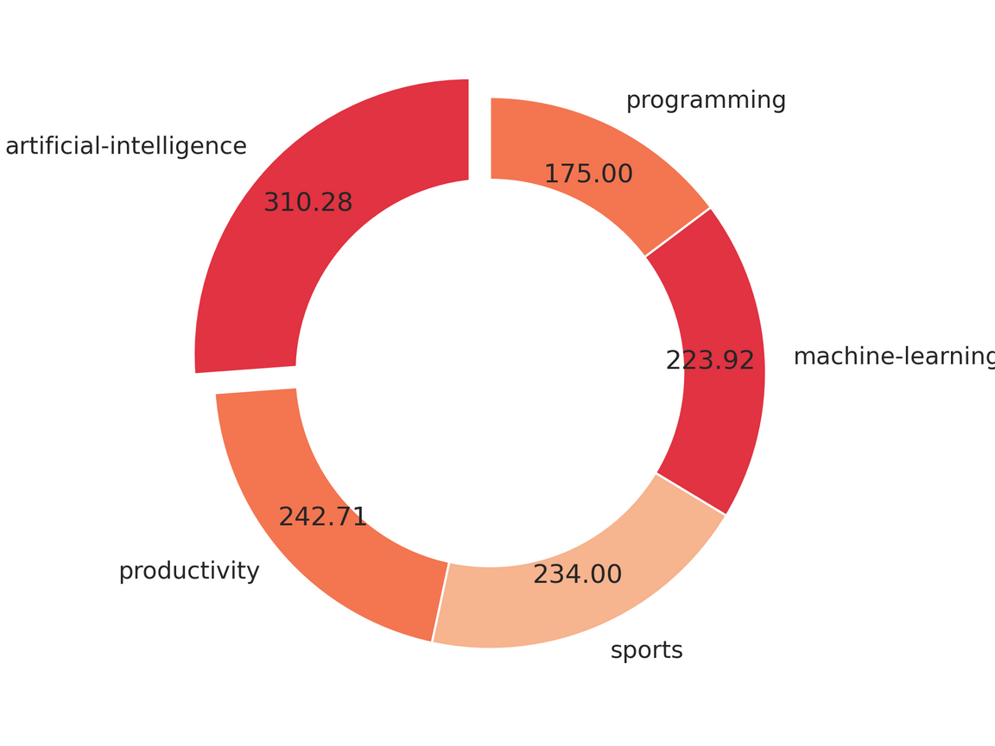
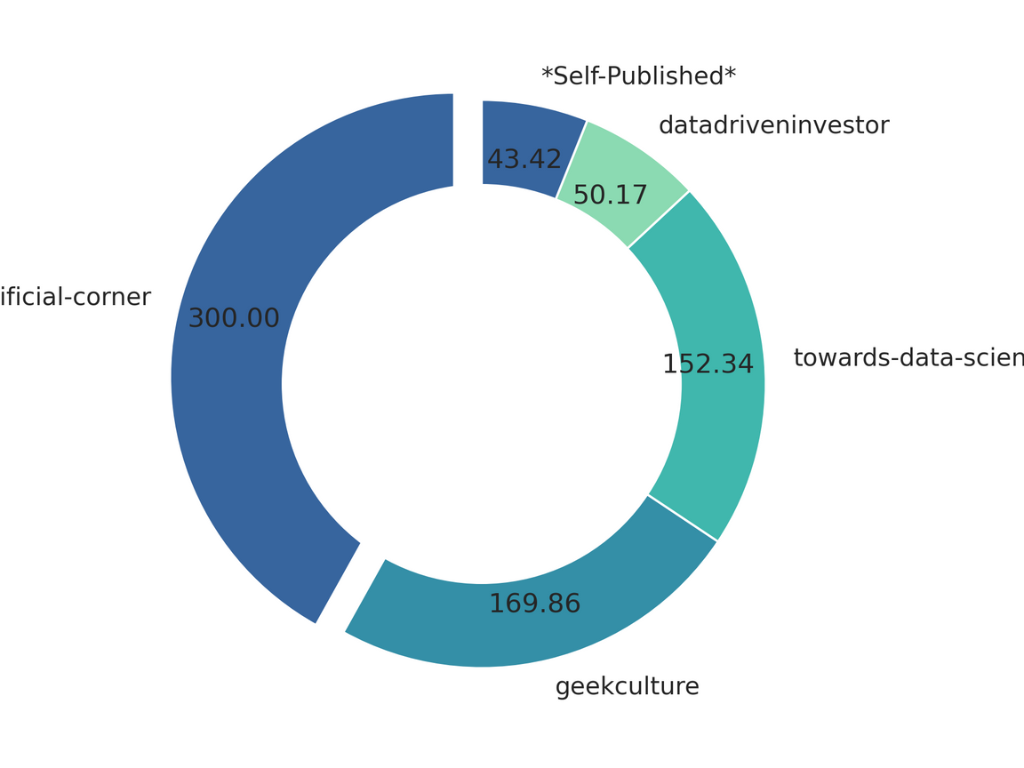
Publications that performed in favor of the author the most
Topics that have accumulated the most attention from readers
Here the values show the average number of voters per article in that topic/ publication

Slide 16
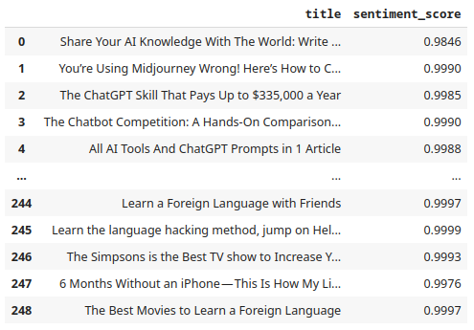
SENTIMENTAL ANALYSIS
Following are the results of the sentimental analysis we got by using NLTK library:
The majority of the articles exhibit a highly positive sentiment, with scores approaching 1. This outcome was anticipated, as the subject matter pertains to learning data, which typically involves a positive and explanatory approach.

Slide 17

SUMMARIZATION
We utilized txt.ai's summarization model to effectively condense lengthy articles into concise summaries of less than 50 words, which were then stored for future use. This approach aimed to improve efficiency, provide a high-level overview, prioritize relevant information, enhance interpretability, and facilitate data reduction during the analysis process.

Slide 18
CONCLUSION
We utilized the Medium API's Python package to import author's data and analyzed it using pandas dataframe, which proved to be effective and efficient.
The retrieved data provided valuable insights into the author's performance and engagement metrics, allowing us to gain a deeper understanding of their content's reach and impact.
The analysis revealed the author's popular topics, audience engagement patterns, and content performance over time, informing content strategy and identifying growth opportunities.
Visualizations in appropriate charts and graphs aided in effectively communicating the findings to stakeholders, facilitating easier understanding of performance visually.

Slide 19

RESOURCES
Code for this Project:
https://colab.research.google.com/drive/1YIArScpRodVWvWgOo_xtioxjRmvLtEte?usp=sharing
Medium API Documentation:
https://docs.mediumapi.com/
Medium API Python Package:
https://pypi.org/project/medium-api/

Slide 20




